Slide 1
Gradle and java 11

Slide 2
Gradle
Introduction
Feature & performance
Migrate mvn to gradle
Demo 2 project monolithic and multi modules
JAVA 11

Slide 3

Introduction
Gradle is an open-source build automation tool that is designed to be flexible enough to build almost any type of software

Slide 4
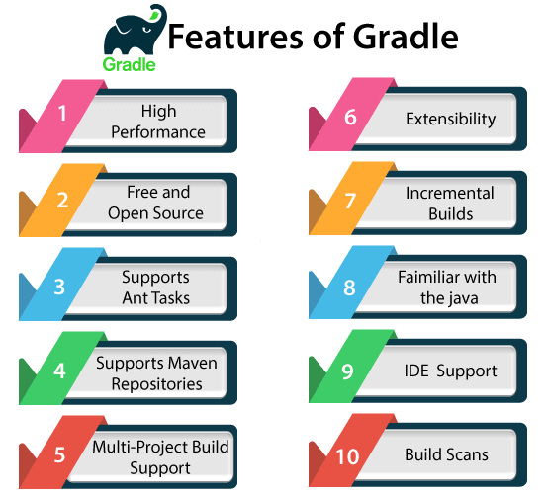
Features

Slide 5
Features
High performance: Gradle quickly completes the task by reusing the output from the previous execution. It processes tasks whose only input is changed and executes the task in parallel. Thus it avoids unnecessary tasks and provides faster performance.
Extensibility: Extensibility is one of the decent features of Gradle. We can easily extend the Gradle to provide our task types or build models. For an example of this, see Android Build Support: It adds several new build concepts such as flavor and builds types.
Build scan: The Build Scans provides comprehensive information about build run that can be used to identify build issues. They also help us to diagnose the problems with a build's performance. The build scans can be shared with others; this can be useful if we need the advice to fix an issue with the build.

Slide 6
Performance
Link: https://gradle.org/maven-vs-gradle/
Flexibility: Google chose Gradle as the official build tool for Android; because Gradle is modeled in a way that is extensible in the most fundamental ways. Gradle's model also allows it to be used for native development with C/C++ and can be expanded to cover any ecosystem.
Performance
Incrementality: only processing files that changed when possible.
Build Cache: Reuses the build outputs of any other Gradle build with the same inputs, including between machines.
Gradle Daemon : A long-lived process that keeps build information "hot" in memory.

Slide 7
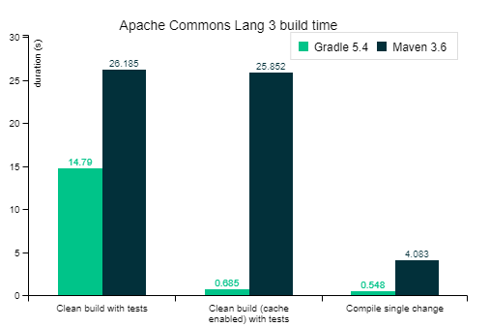
Performmance (2)
These and more performance features make Gradle at least twice as fast for nearly every scenario (100x faster for large builds using the build cache) in this Gradle vs Maven performance comparison.

Slide 8
Migrating Builds From Apache Maven
Create a build scan for the Maven build.
project structure, what plugins are being used, a timeline of the build steps, and more.
compare it to the Gradle build scans you get while converting the project
Verify that the two builds produce the same artifact
Focus on the critical output such as final reports and the artifacts that are published or deployed.
Run an automatic conversion
Create all the Gradle build files you need
Include
All the custom repositories that are specified in the POM
Your external and inter-project dependencies
The appropriate plugins to build the project

Slide 9
Continue
Verify your dependencies and fix any problems
Declaring dependencies
Declaring repositories
Controlling dependency versions
Handling optional dependencies
Configure integration and functional tests
Many tests can simply be migrated by configuring an extra source set
Replace maven plugins with gradle equivalents

Slide 10
Java 11
Http Client API
Launch single-file programs without compilation
String API changes
Collection.toArray(IntFunction)
Files.readString() and Files.writeString()
Optional.isEmpty()

